Slide 1
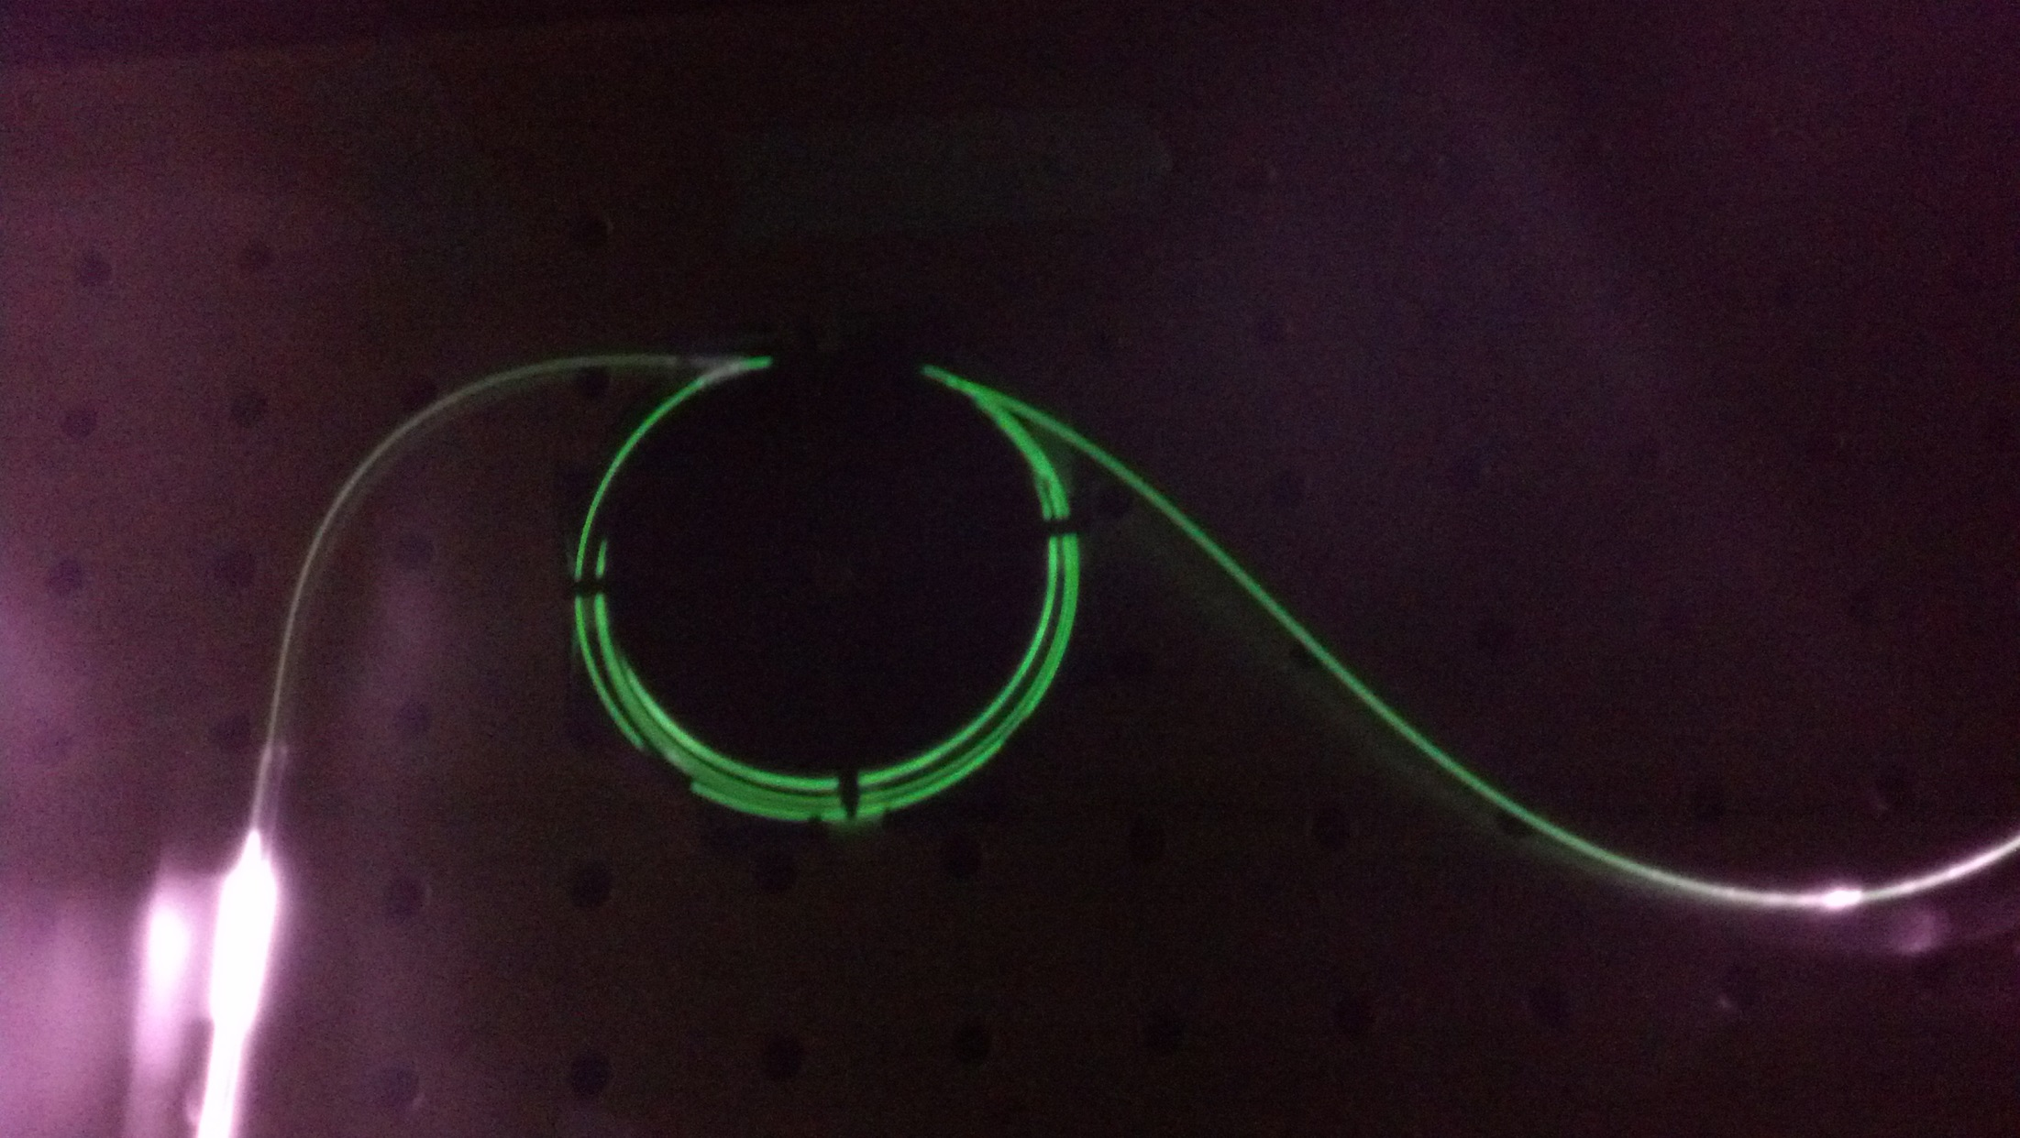
High Power Double-Clad Fiber Laser
Matt Ruby & Colin Diehl

Slide 2
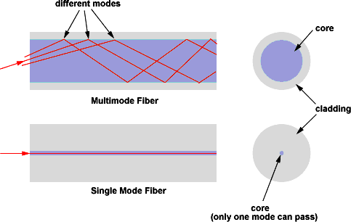
Single-mode Fiber
High Beam Quality
Low Propagation Loss
Lower Power Pump
Expensive
Multimode Fiber
Higher Power Pump
Inexpensive
Poor Beam Quality
High Propagation Loss

Slide 3
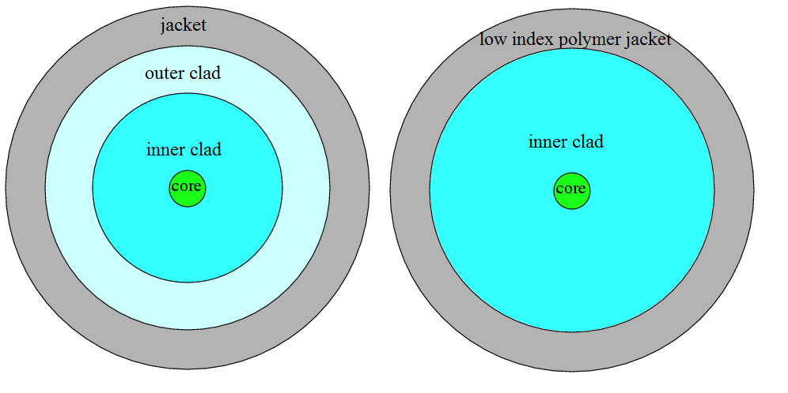
Double-Clad Fiber
Laser light propagates in single-mode core
Pump light propagates in inner cladding

Slide 4
Laser Construction

Slide 5
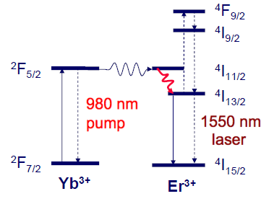
Erbium-Ytterbium Co-Doped Fiber
Erbium-Ytterbium co-doped gain medium
980 nm pump laser
Radiationless decay
Stimulated emission of 1550 nm

Slide 6
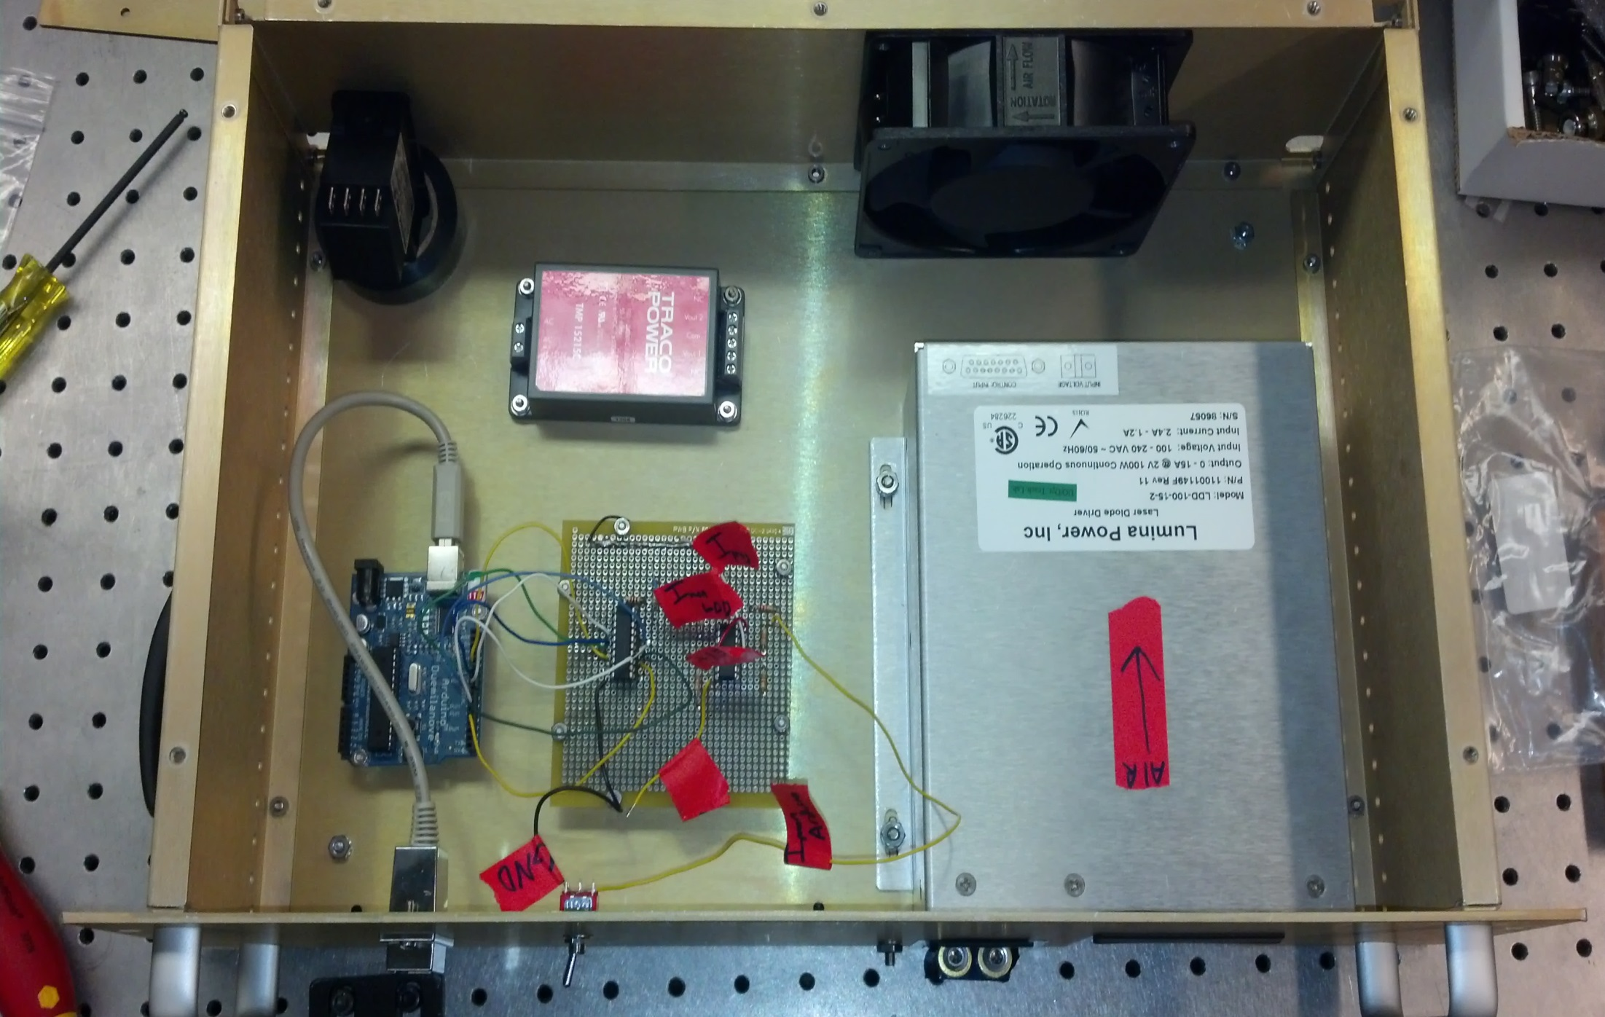
Box Layout

Slide 7
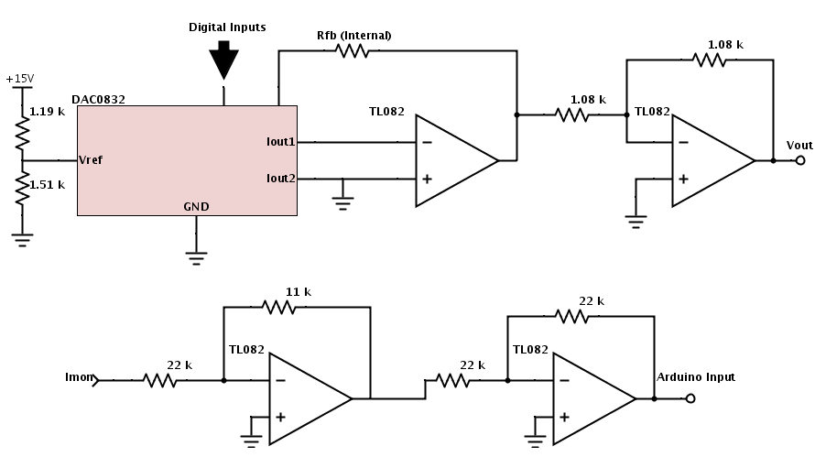
Box Layout

Slide 8
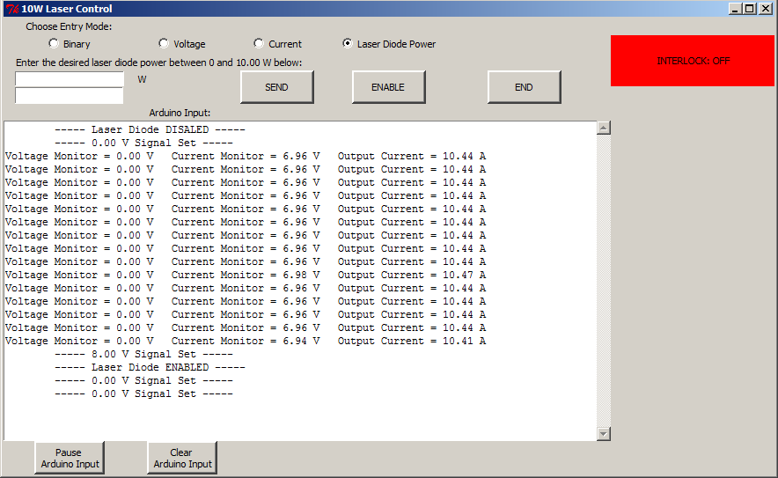
Box Layout

Slide 9
Laser Construction

Slide 10
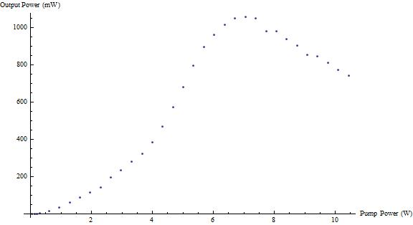
Output Power
1.5 m EYDF 90/10 Coupler

Slide 11
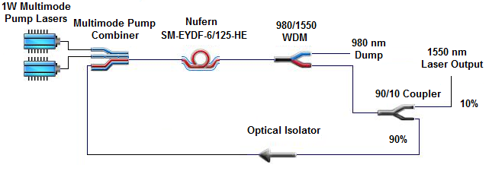
New Laser Construction

Slide 12
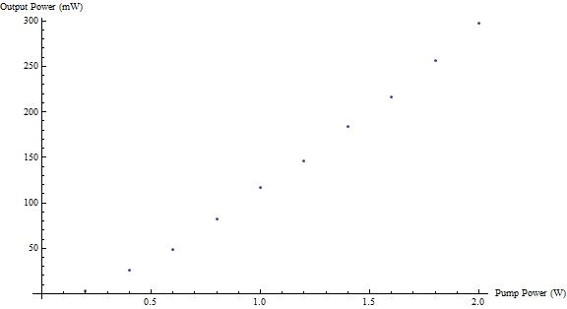
Output Power
3 m EYDF 90/10 Coupler

Slide 13
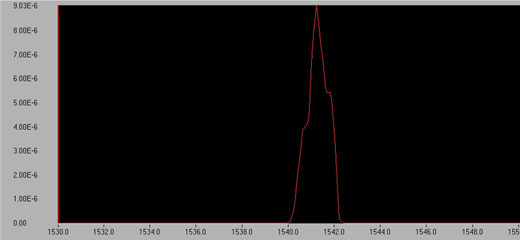
Laser Spectrum

Slide 14
Laser Self Pulsing
Pulsing condition
Low pump power
When the pump is not able to maintain a complete population inversion, then the gain medium acts like a saturable absorber.
Long cavity length
When the cavity length is long the light pulse will have more time till it is fed back into the gain medium, allowing the pump time to start saturating the gain medium again.

Slide 15
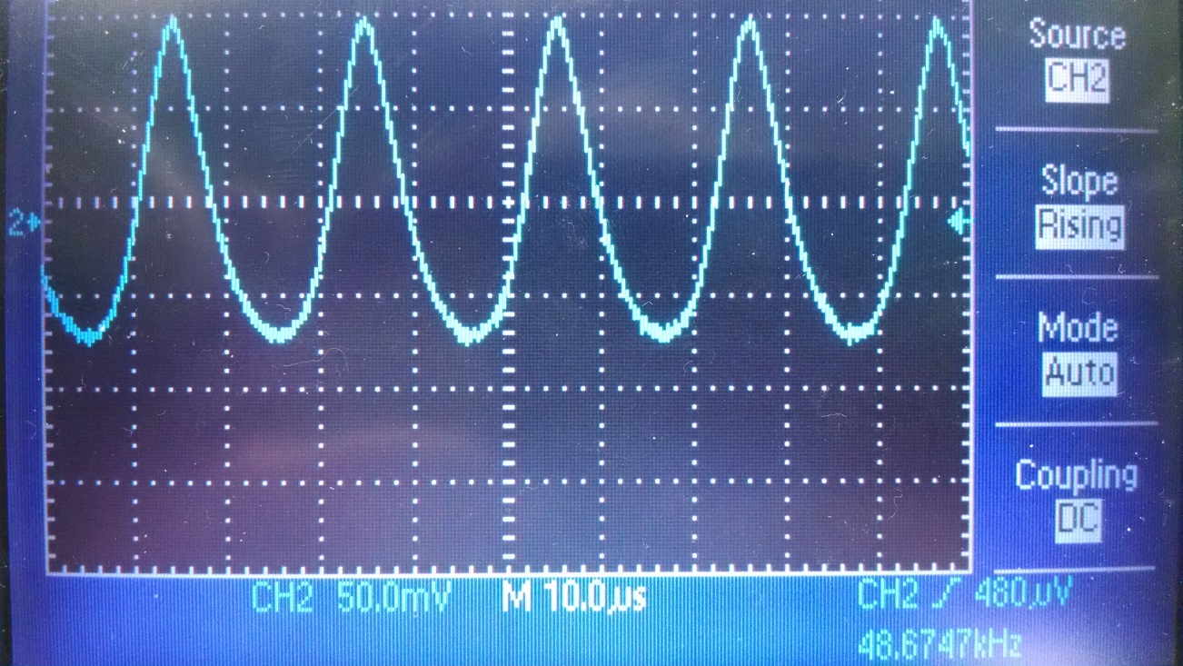
Evidence of Self Pulsing
Our laser has the right specs for self pulsing
Long erbium fiber ~ (3m)
Very long cavity ~ (12.5m)
Output @ 1540nm and 975nm /w 500mW pump

Slide 16
Conclusion
Self pulsing verified
By correlating the pump and signal oscillations at different pump powers.
Pulsing is suppressed after about 550mW pump
Pulse frequency increases with pump power
Conclusion
We have shown that self pulsing in our fiber laser is a problem at pump powers lower than 500mW, though this is not a problem as our setup can supply more than enough power to suppress the pulsing.

Slide 17
Future Work
Add frequency selective components
Braggs grating
Fabry-Perot Cavity
Fine frequency measurement
Fabry-Perot Cavity
Higher power pump laser

