Slide 1
Double-Clad Erbium-Ytterbium Co-Doped Fiber Laser
Matt Ruby & Colin Diehl

Slide 2
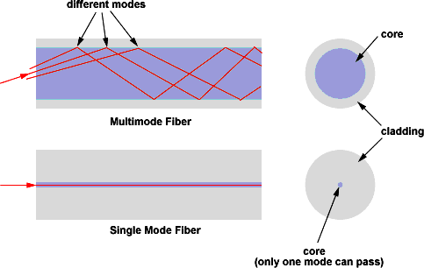
Single-mode Fiber
High Beam Quality
Low Propagation Loss
Lower Power Pump
Expensive
Multimode Fiber
Higher Power Pump
Inexpensive
Poor Beam Quality
High Propagation Loss

Slide 3
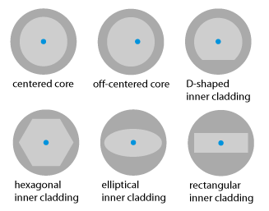
Types of Double-Clad Fiber

Slide 4
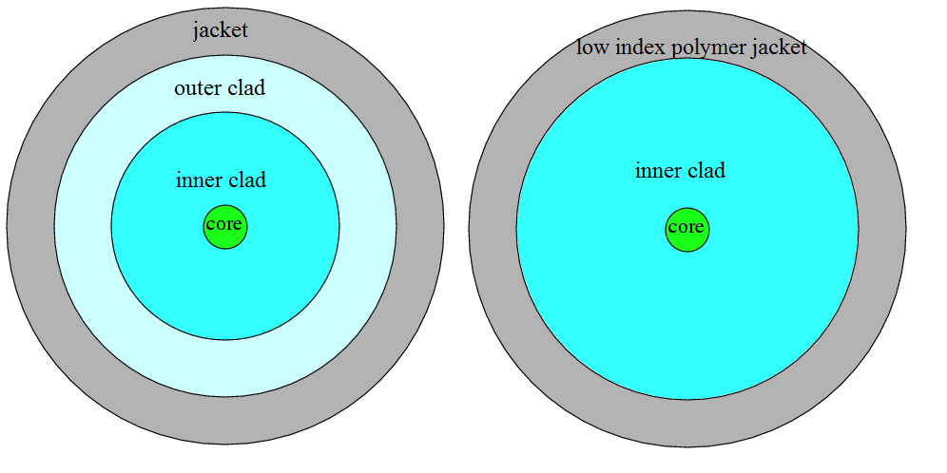
Our Double-Clad Fiber

Slide 5
Our Double-Clad Fiber
Type: Centered Core
Specs:
Core Diameter 6µm
First Cladding 124µm
Second Cladding 240µm, polymer coating
Reasons of Centered Core Fiber
Compatible with smf-28
Easy to connectorize with current tools

Slide 6
Laser Construction

Slide 7
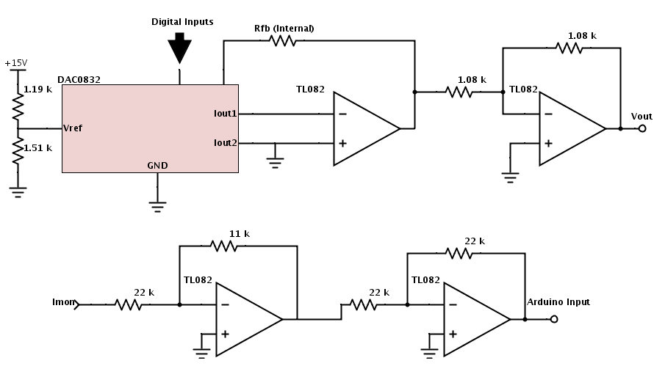
Arduino Control Circuit

Slide 8
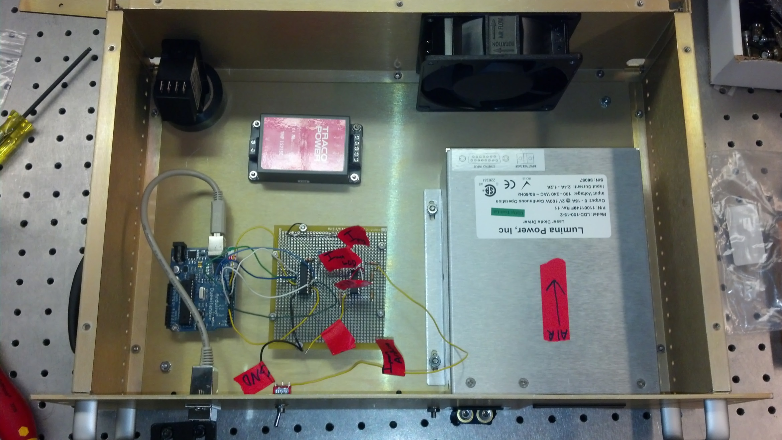
Box Layout

Slide 9
Development
Initial problem
Huge power loss with MM FC/APC to DC FC/APC
Unknown 2nd cladding
Findings
FC coupler took the 2nd cladding of therefore the epoxy acted as the 2nd cladding
Solution
Used a MM 3x1 coupler to avoid using FC couplers

Slide 10
Development
Second Problem
Fusion splices burnt out of their splice protectors
Findings
The hot glue that the protectors used coupled light out of the fiber, just like the FC epoxy
Solution
We used a 1mm dia metal tube to protect the bare part of the spliced fiber, and put the protector over the tube; so the hot glue only touched the coating of the fiber

Slide 11
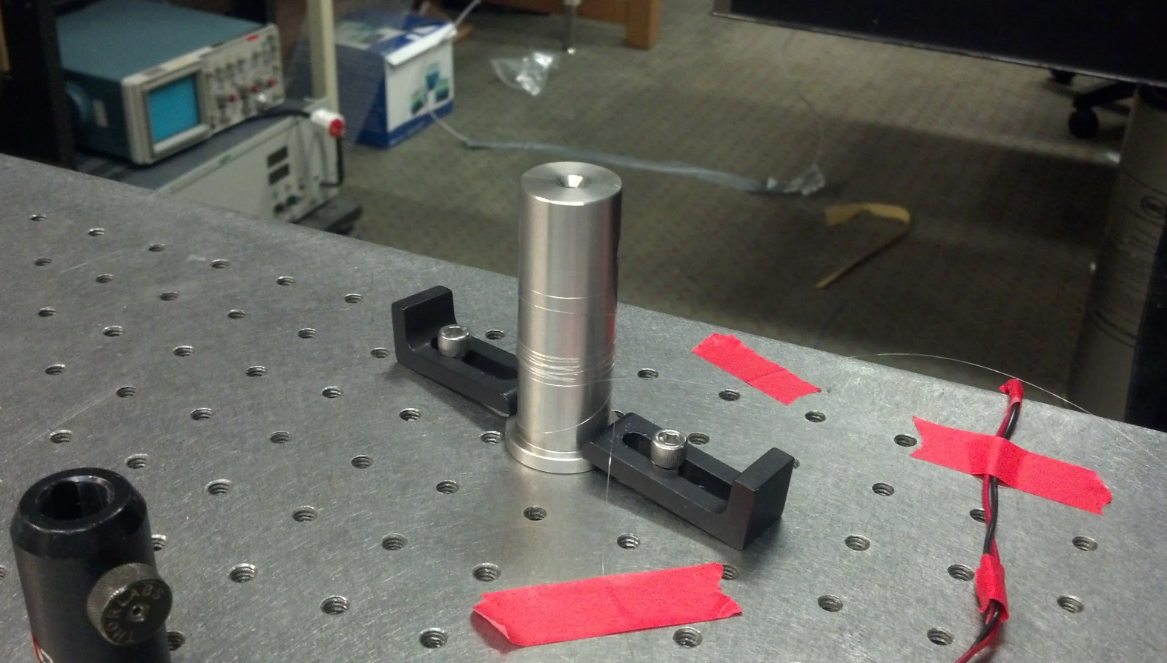
Double-Clad Fiber Mode Structure
Fiber Modes
Radial
Azimuthal
Problem
Radial mode suppressed in Pump beam by the fiber core
Solution
Use mode-scrambling techniques to redistribute modes.

Slide 12
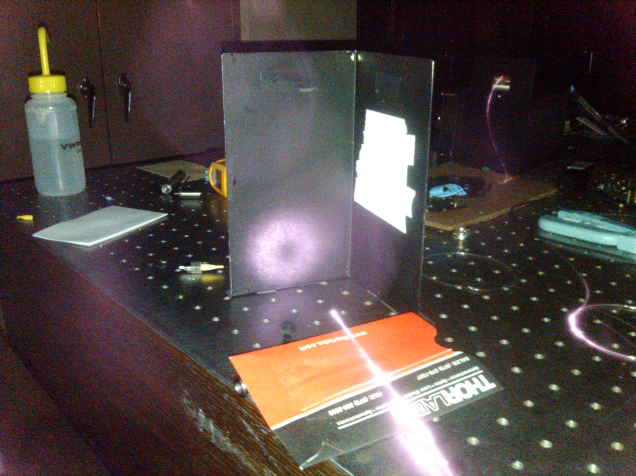

Slide 13
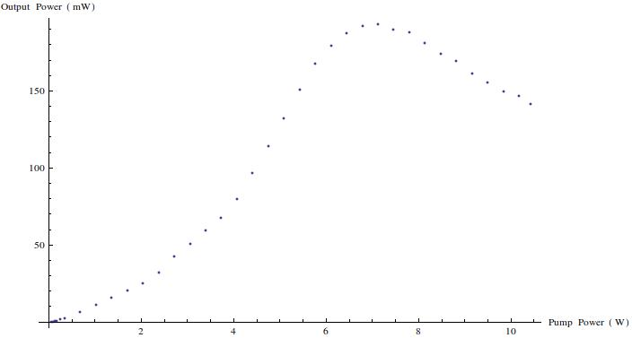
Pump Vs Output
Findings
We assume that the power loss after 7.1 W pump is created from thermal losses or Stimulated Brillouin scattering (SBS)

Slide 14
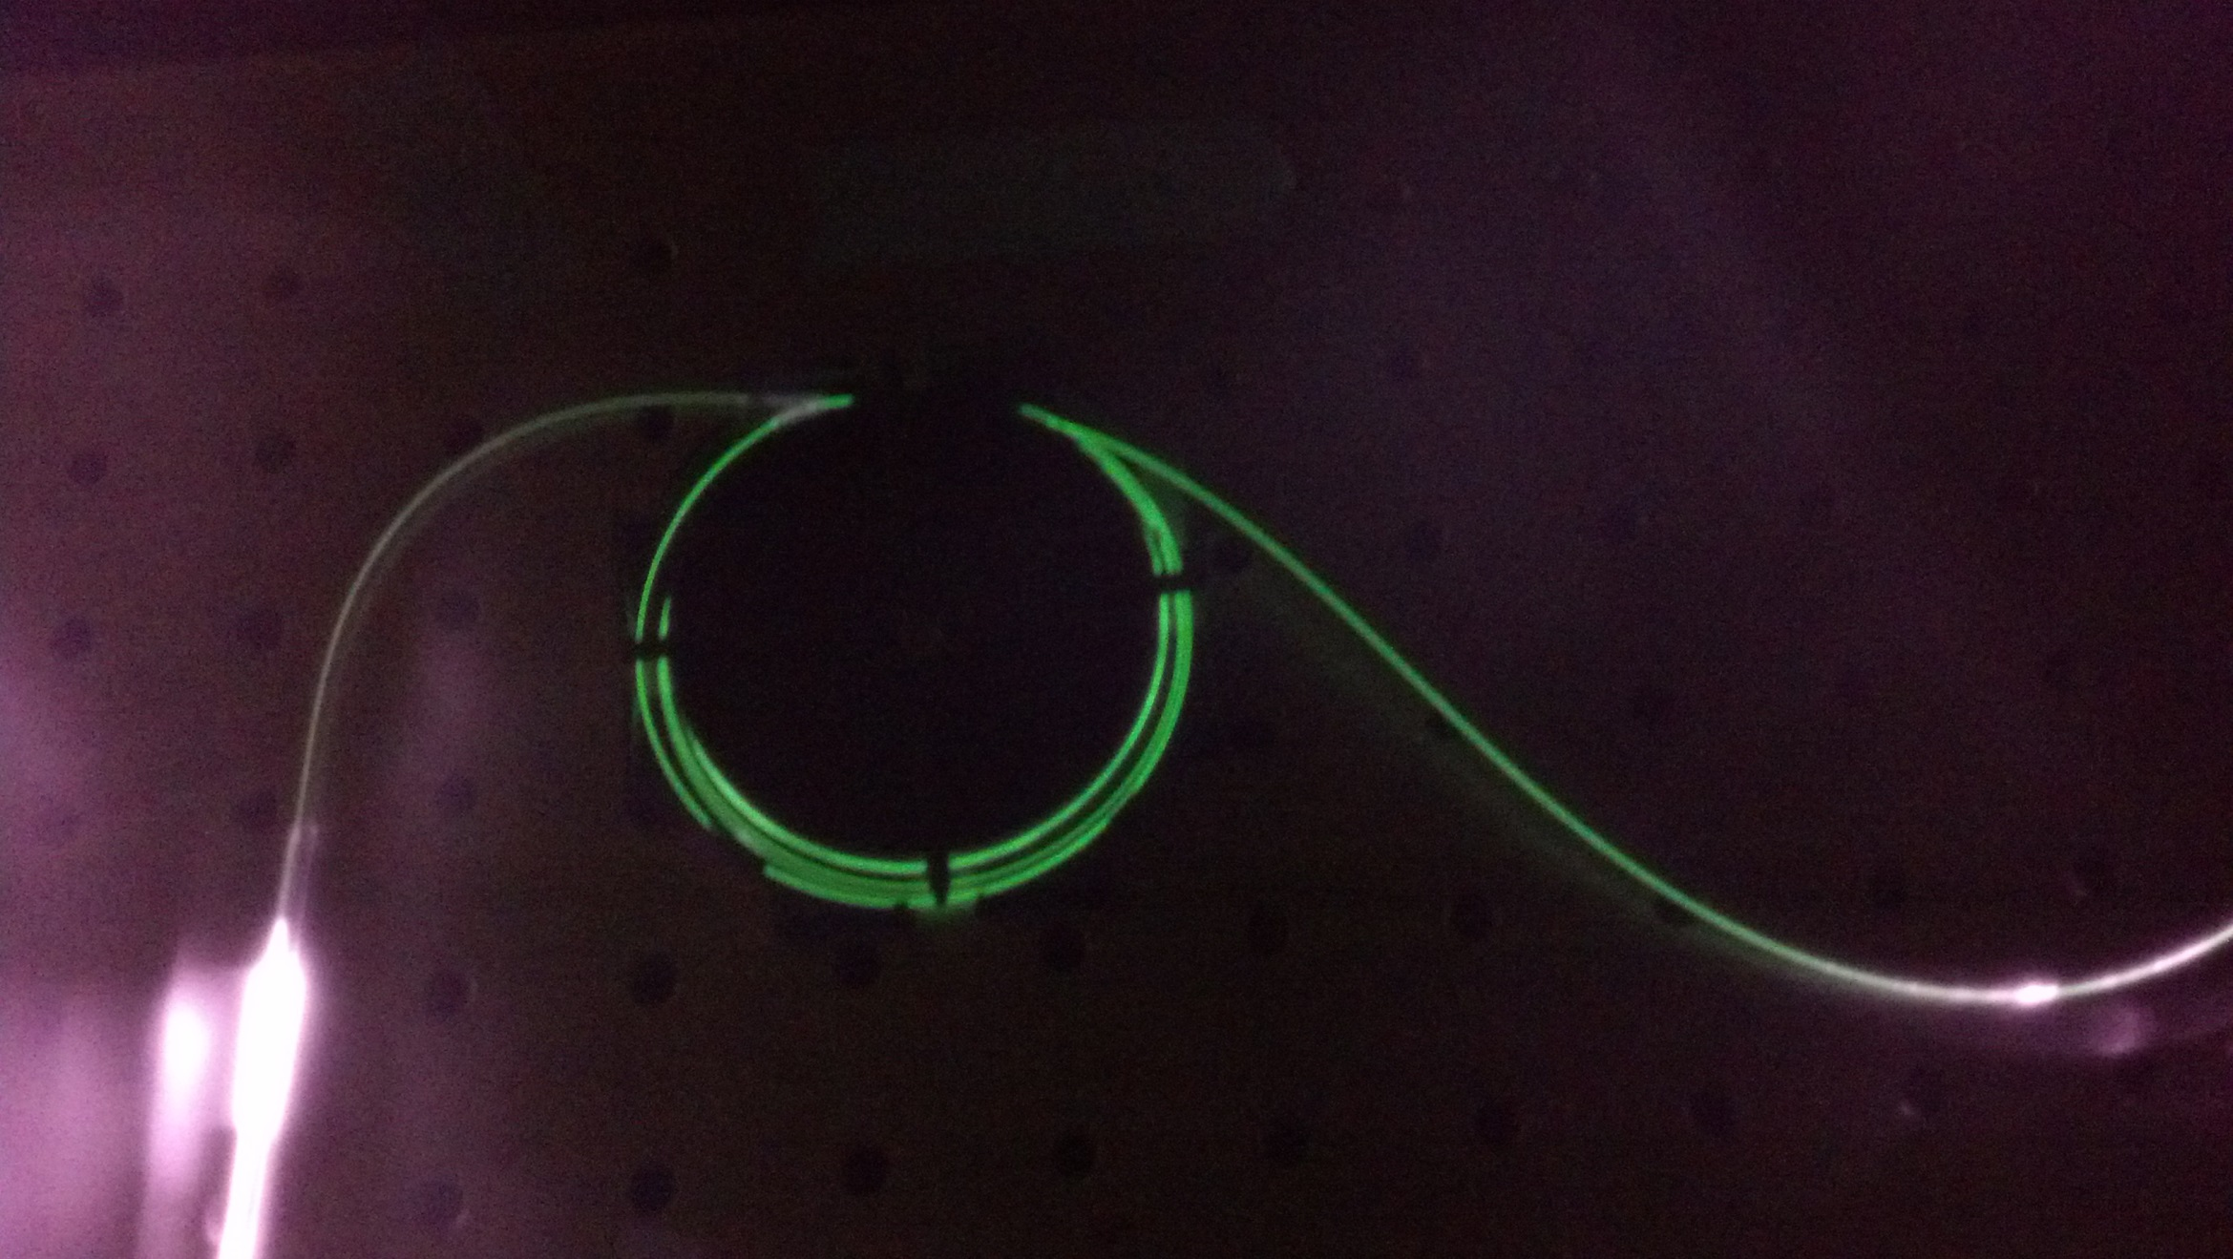

Slide 15
SBS
Phonon photon scattering
Thermal effects
Signal effects
How to Observe
SBS is a reverse propagating wave
SBS has an intrinsic frequency shift of 10 – 20 MHz(3)

Slide 16
Future Work
Test for SBS
Use a 2X2 output coupler to take the back reflected light out of the cavity, then measure frequency relative to the lasers output frequency.
Optimization
Add a second MM WDM to dump the 980nm light out of the system
Alter EYDF length
Try different output couplers

Slide 17
References
Fig 1 http://en.wikipedia.org/wiki/File:Singlemode_fibre_structure.svg
Fig 2: http://en.wikipedia.org/wiki/File:OfsetDCF.png
(3) http://www.rp-photonics.com/brillouin_scattering.html

