Slide 1
Spontaneous Parametric Down Conversion
Advanced Projects Lab Summer
2015 GIP Projects
Alexander Watt & Michael Hirte

Slide 2
SPONTANEOUS WHAT?
Spontaneous parametric down conversion (SPDC) is a non-linear process that takes place when specially engineered optical crystals (e.g. Beta Barium Borate) are used.
This process will “split” the incident light beam into two beams, a “signal” & a ”idler” beam, at a well defined angle w.r.t. the pump axis.

Slide 3
Why SPDC?
Spontaneous : There is no input signal or idler field to stimulate the process: they are generated spontaneously inside the crystal.
Parametric : An optical process in which light interacts with matter in such a way as to leave the quantum state of the material unchanged.
Down-Conversion: Signal and idler fields always have a lower frequency than the pump.

Slide 4
Why would a physicist care about SPDC?
It is one of the most interesting quantum phenomena of nonlinear optics that has no classical correspondent.
It is efficiently used in spectroscopy, quantum metrology, quantum optics, and quantum informatics.
Most works on quantum optics and quantum informatics, that are associated with investigation and application of quantum features of the EMF, are based on SPDC.

Slide 5
Main Objective: Successfully build a quantum eraser
Necessary steps:
Determine max. # counts vs. angle
Determine max. # coincidences vs. angle
Determine the correct value for a classical & quantum field
Build a polarized interferometer
Observe single photon interference

Slide 6
SPDC is an optical parametric process of the spontaneous decay of monochromatic radiation (pumping) photons, incident on the medium w/ frequency into a pair of signal ( frequency ) and the idler (frequency ) photons: (1) (2)
idler
signal
beam blocker

Slide 7
Laboratory setup for determining the counts/coincidences vs. angle
Pump beam
λ/2
BBO
B’
B
A

Slide 8
No. of counts registered when the PDA & PDB were varied w.r.t optical input axis. Maximum # of counts s at PDA was when Maximum # of counts s at PDB was when

Slide 9
On average, were registered 278 coincidences/0.5s when PDA was set at , and PDB at w.r.t. optical input axis.

Slide 10
g⁽²⁾(0) Measurements

Slide 11
Degree of Second-Order Coherence
Classical | Quantum
Waves | Particle-Waves
g⁽²⁾(0) 1 | g⁽²⁾(0) 1
Positive Correlation | Negative Correlation
Bunching | Anti-Bunching
Image source : https://upload.wikimedia.org/wikipedia/commons/8/86/Photon_bunching.png

Slide 12
Calculation of g⁽²⁾(0)
(3)
I_{B}(t) & I_{B’}(t) are the intensities of fields transmitted and reflected to detectors B & B’.
τ is the time delay between intensity measurements.

Slide 13
Calculation of g⁽²⁾(0)
continued
I_{I} is the intensity of the field incident on the beam splitter
α and β are the transmission and reflection coefficients, respectively
(4)

Slide 14
Result | Setup | Average g⁽²⁾(0) | Standard Deviation
Classical | 2 Detector | 5.89 | 0.33
Quantum | 3 Detector | 0.49 | 0.22

Slide 15
Classical g⁽²⁾(0) vs. Quantum g⁽²⁾(0)
Two detector measurements detect a classical field.
Classical result: g⁽²⁾(0) ≥ 1
Three detector measurements, conditioned on A counts, detect a quantum field.
Quantum Result: g⁽²⁾(0) < 1.

Slide 16
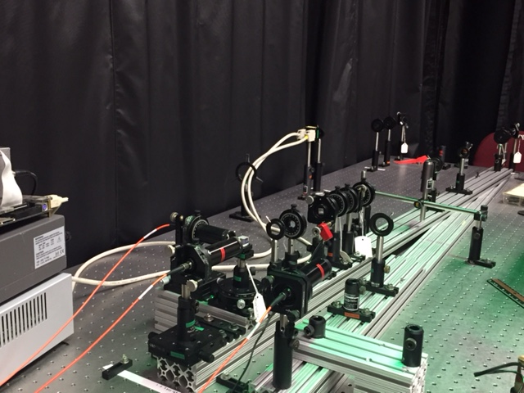
Polarization Interferometer
λ/2
BBO
λ /2
PBS
BDP

Slide 17
Single photon interference
If we see a sinusoidal pattern in B & B’ counts as we rotate the BDP in a circular horizontal plane, we are seeing an interference pattern.
If g⁽²⁾(0) < 1 and we see the same sinusoidal pattern in AB & AB’ coincidence counts, we are witnessing single photon interference.

Slide 18
Single photon interference
A
B
B’
AB
AB’
ABB’

Slide 19
Entanglement “Spooky action at a distance” Albert Einstein
Type I down conversion
λ/2
E
45°
1
H
V
Δ is the phase diff. due to the birefringence & dispersion in the crystals
(5)

Slide 20
Quantum eraser setup
Q
DBBO
PI

Slide 21
The dancing photon…no partner at this time, just interfering w/ itself…

Slide 22
References:
Beck, Mark. Quantum Mechanics: Theory and Experiment. New York: Oxford UP, 2012. Print.
Kitaeva, G. Kh., and A. N. Penin. "Spontaneous Parametric Down-conversion." Jetp Lett. Journal of Experimental and Theoretical Physics Letters 82.6 (2005): 350-55. Web.
Wiersig, J., C. Gies, F. Jahnke, M. Aßmann, T. Berstermann, M. Bayer, C. Kistner, S. Reitzenstein, C. Schneider, S. Höfling, A. Forchel, C. Kruse, J. Kalden, and D. Hommel. "Direct Observation of Correlations between Individual Photon Emission Events of a Microcavity Laser." Nature 460.7252 (2009): 245-49. Web.
Dehlinger, Dietrich, and M. W. Mitchell. "Entangled Photons, Nonlocality, and Bell Inequalities in the Undergraduate Laboratory." Am. J. Phys. American Journal of Physics 70.9 (2002): 903. Web.
http://hank.uoregon.edu/wiki/index.php/APL:Community_portal
Private communication:
Dr. Brian Boggs, Dr. Nima Dinyari, Ph.D. candidate Roger Smith

