Slide 1
Two-Slit Interference, One Photon at a Time
By:
Kevin Masson

Slide 3
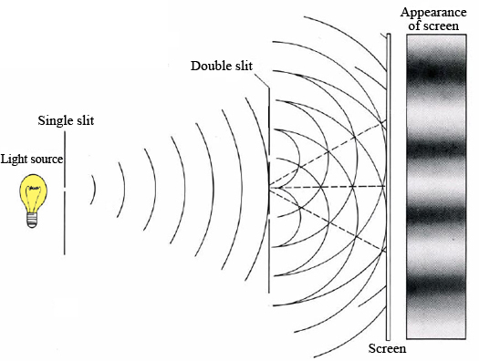

Slide 4
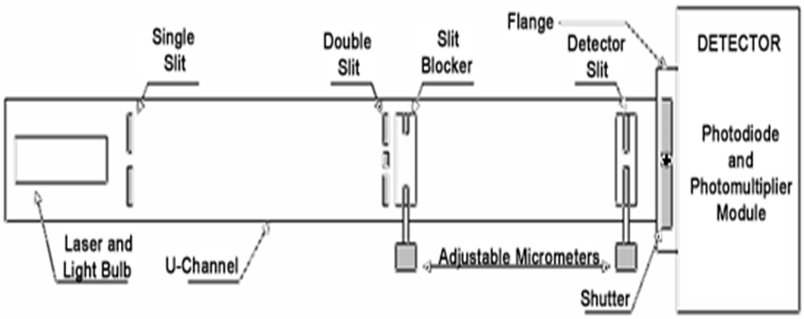
I then found positions of the slit blocker that would effect the double slit, there are five positions;
Far side with both slits blocked, allowing no light to pass.
Allowing light to emerge from far slit only.
Allowing light to emerge from both slits.
Allowing light to emerge form near slit only.
Near side with both slits blocked, allowing no light to pass.

Slide 5
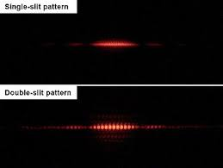
At position 1 and 5: No image is shown on the notecard.
At position 2 and 4: A diffraction pattern similar to that of the single slit pattern below is present on the notecard.
At position 3: A diffraction pattern similar to that of the double slit pattern below is present on the notecard.

Slide 6
Light Intensities
In this part of the experiment I record the voltage output of the light after it hits the photodiode detector

Slide 7
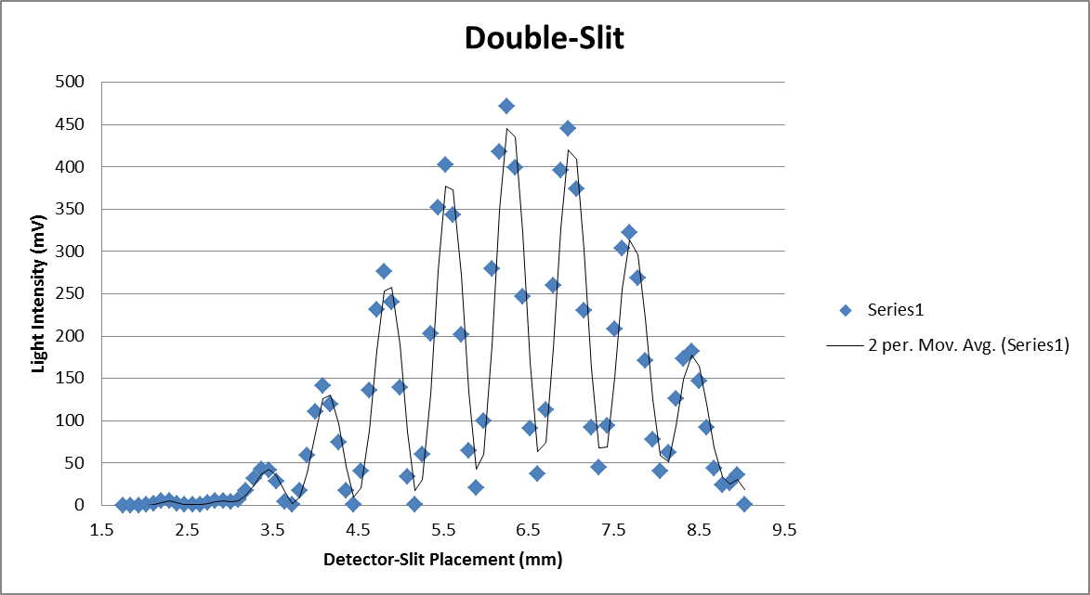

Slide 8
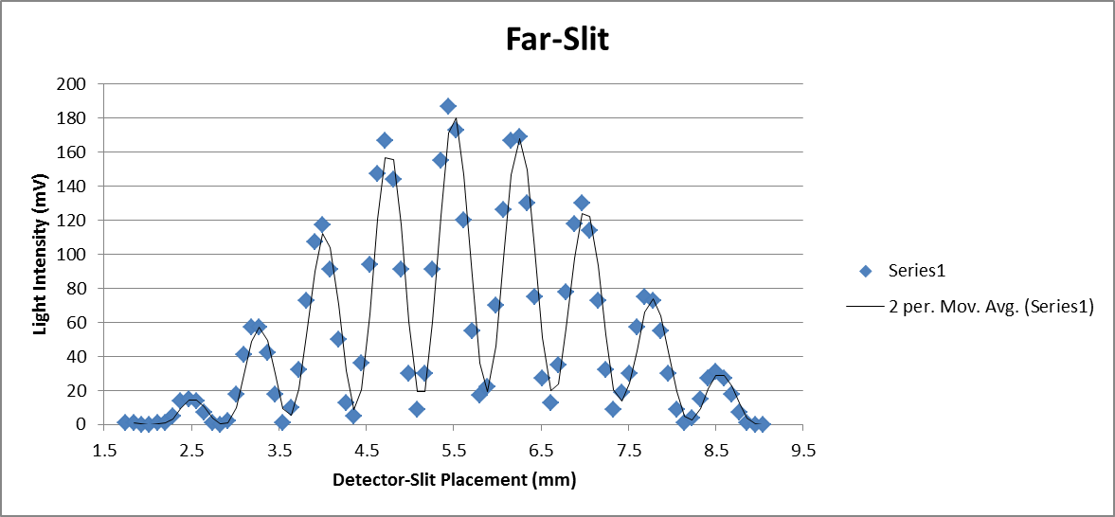

Slide 9
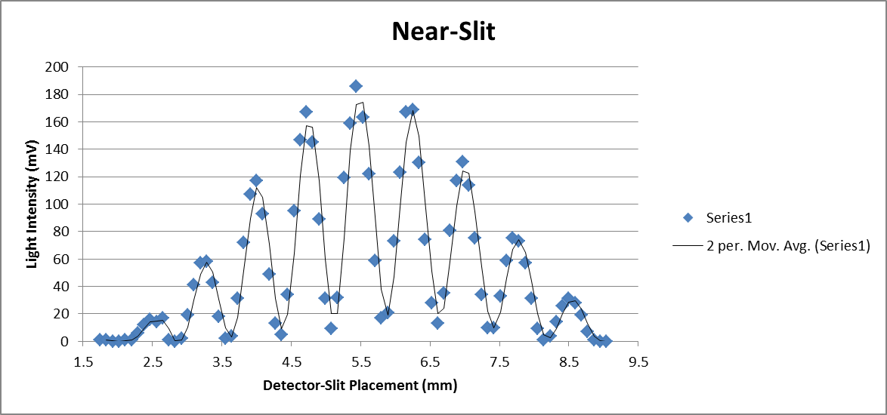

Slide 10
Ratio of Light
The central maxima of the double slit had an intensity of 472mV at 6.25mm and the far slit at 6.25mm had an intensity of 169mV resulting in a ratio of light permitted through far slit v. both slits
$$\frac{169}{472}=0.358$$
The near slit had an intensity of 169mV at 6.25mm which results in the same ratio as that of the far slit

Slide 11
Single Photon
Here I set up the Photomultiplier Tube to collect the light as it passes through the detector slit and then I record the photon count per second. Here I am no longer using the laser, I have switched to a fairly dim lightbulb.

Slide 12
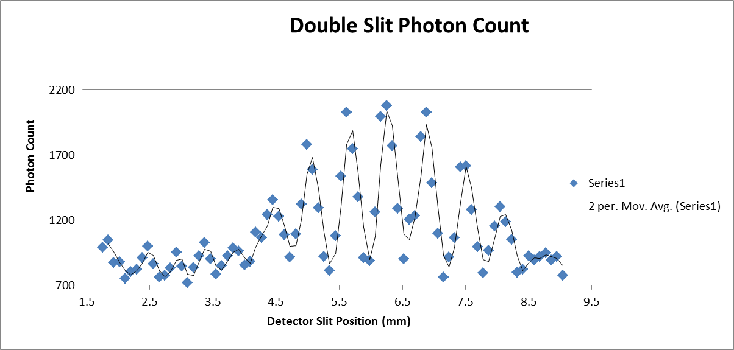

Slide 13
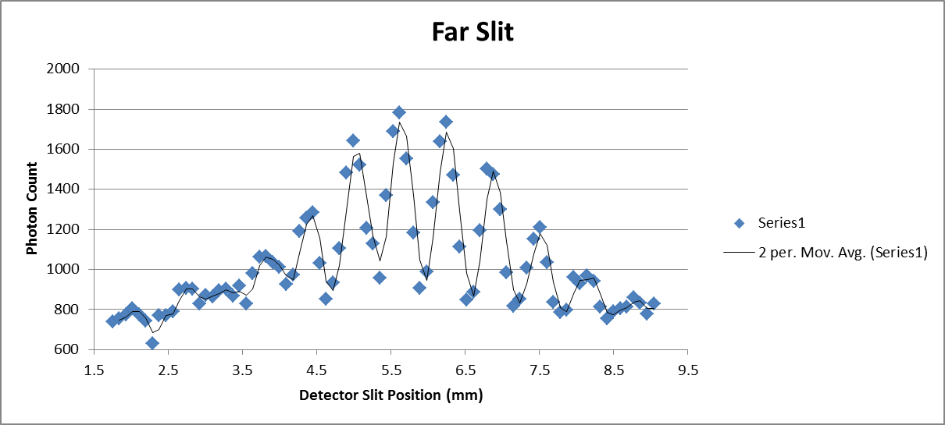

Slide 14
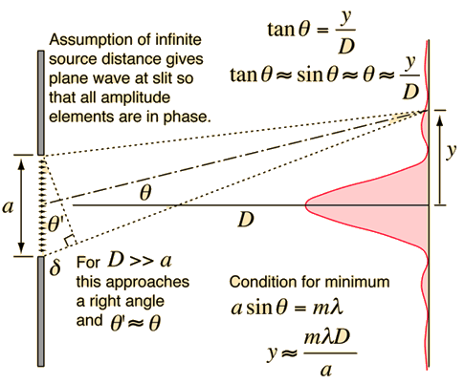
Fraunhofer Diffraction

Slide 15
Intensity
The Intensity of light is given by:
$$I\left(θ\right)=I_{0}{(\cos{β})}^{2}({\frac{sinα}{α})}^{2}$$
where $α=\frac{πa}{λ}sinθ$ and $β=\frac{πd}{λ}sinθ$.
a is the width of the slits in the double slit
d is the center to center separation distance.

Slide 16
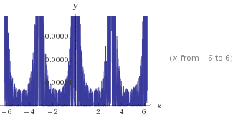

Slide 17
Sources
Nave, R.. "Fraunhofer Diffraction Geometry." Fraunhofer Diffraction. hyperphysics.phy, n.d. Web. 8 June 2014. <http://hyperphysics.phy-astr.gsu.edu/hbase/phyopt/fraungeo.html>.
"Two Slit Interference, One Photon at a Time by TeachSpin." Two Slit Interference, One Photon at a Time by TeachSpin. TeachSpin, n.d. Web. 29 Mar. 2014. <http://www.teachspin.com/instruments/two_slit/>.

