Slide 1
SagNAC Interferometry
Matt Boggess and Devon Sherrow-Groves

Slide 2
Overview
Intro
Theory
Improvements
Problems
Final Iteration
Data
Conclusions
Future prospects

Slide 3
Introduction
Sagnac effect used in fiber optic gyroscopes
Used for navigation in planes and boats
  Lightweight alternative
Able to make measurements inside an inertial frame

Slide 4
Basic Setup
Source
1550 nm
OI
50/50
2 km loop
Detector
Notes:
Discuss the setup as well as a small amount about connectorization and polishing.

Slide 5
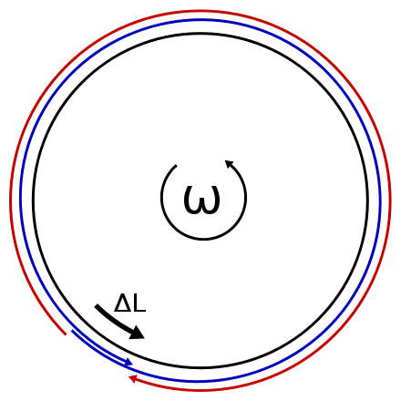
Theory
Counter propagating waves
Difference in path length due to rotation
Causes a phase shift, which causes interference
In/out at t=0
In/out at t=Δt

Slide 6
Second Iteration
Confine inertial frame
Add polarization controller
Optimize detection scheme
Source
1550 nm
OI
50/50
2 km loop
Detector
Polarization
Controller
Rotational Stage

Slide 7
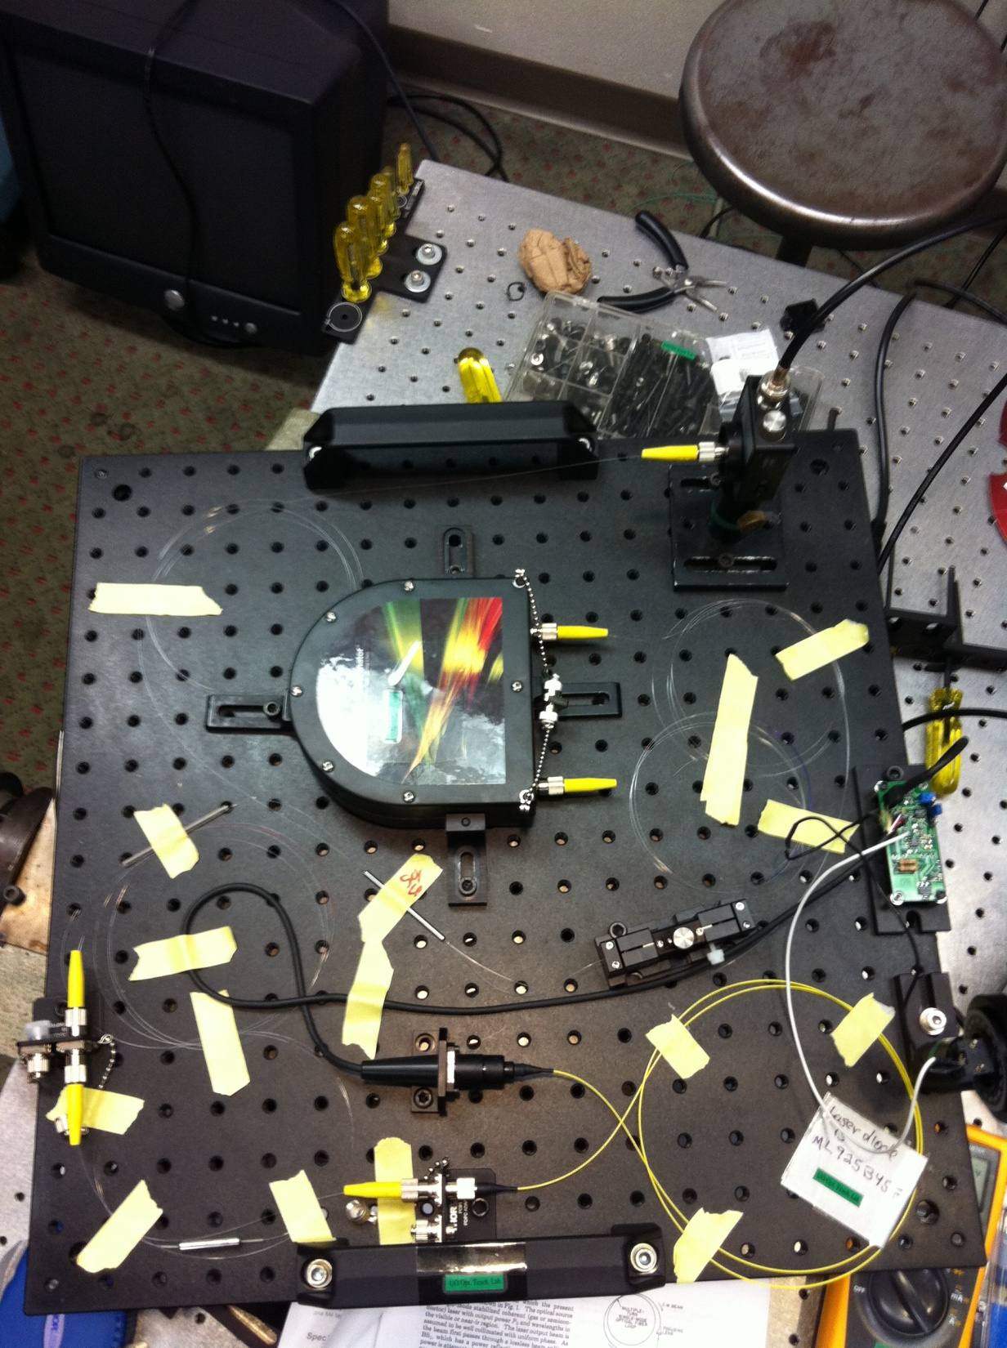
Second Iteration of Sagnac Interferometer

Slide 8
Improvements
Qualitative vs. quantitative
Phase shift measurement
  Rotational rate measurement

Slide 9
Phase Modulator
Radial Expansion
Wrapped PZT cylinder
Expansion causes the fiber to stretch
  Δr = d₃₃ (V)
Path length changes, causing a phase shift
Characterize with a Mach-Zehnder
-
+
out
in
Zero voltage
Nonzero voltage
Notes:
D33- radial tensor element, property of the PZT

Slide 10
Mach-Zehnder Interferometer
Detects interference due to phase difference between two arms
Source
Detector
1550 nm
OI
50/50
50/50
Phase Modulator
Voltage Driver

Slide 11
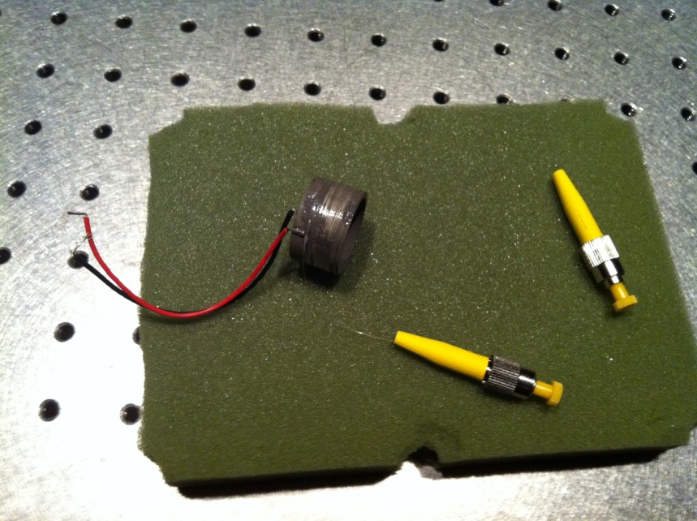
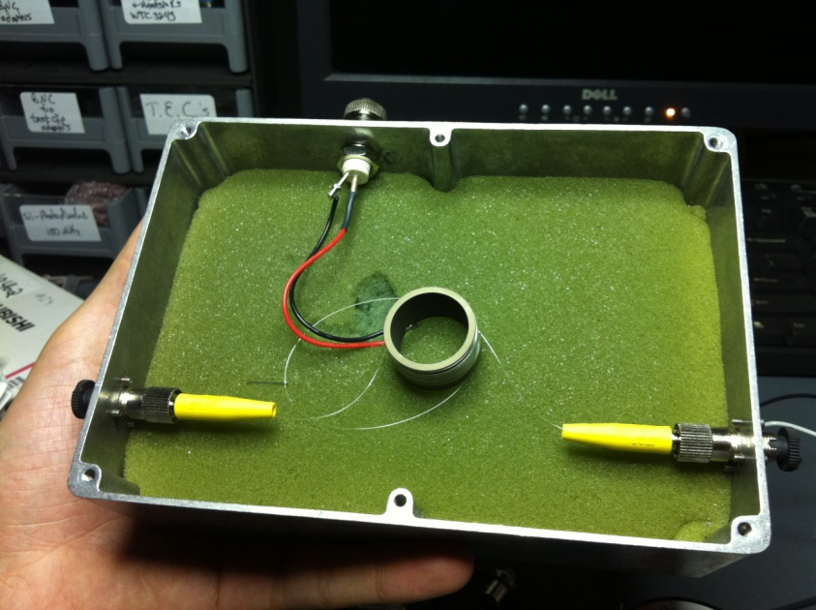
PM Obstacles
Epoxy (20 coil, hand-wrapped)
  Weak bond
  No phase shift visible

Slide 12
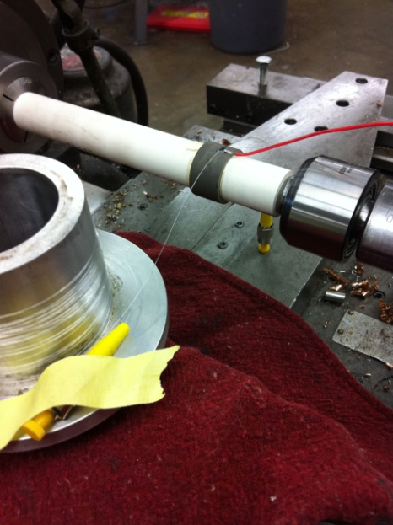
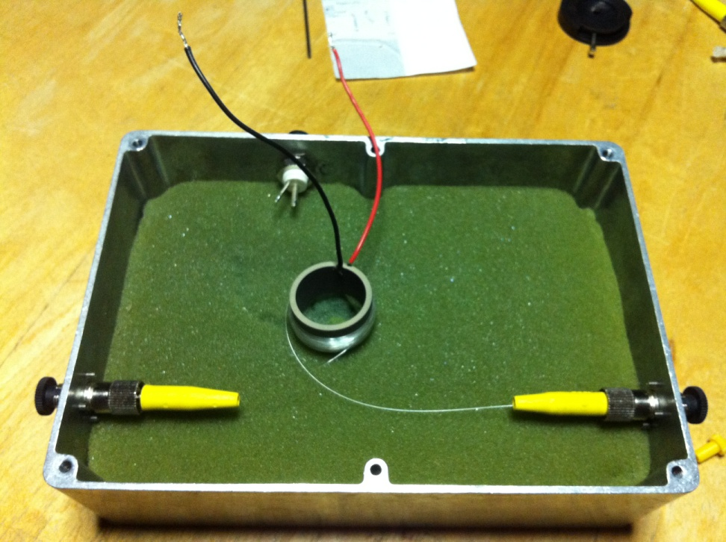
PM Obstacles Cont.
Cyanoacrelate (122 coil, lathe-wrapped)
  Bonding to the plastic coating
  Still no phase shift

Slide 13
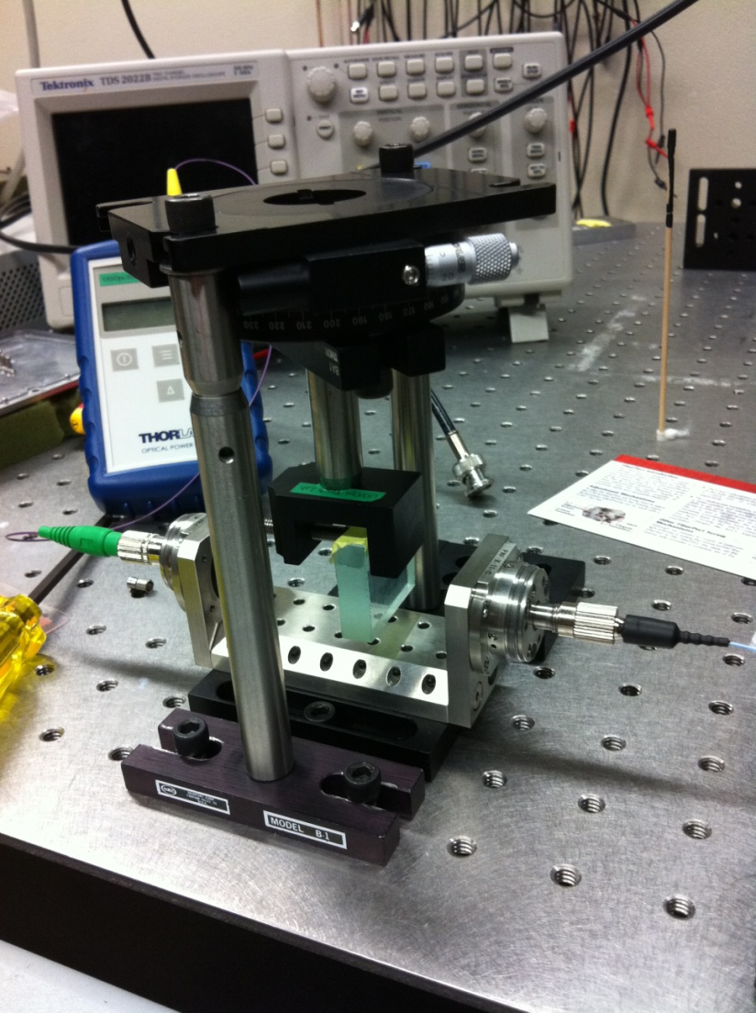
PM Obstacles Cont.
Tensile test
  Breaking fibers
Free space phase shifter test

Slide 14
Third Iteration
Improved design considering 50/50 couplers
Fiber Loop consolidation – Error minimization
Source
1550 nm
OI
50/50
50/50
2 km loop
Detector
Polarization Controller
Terminated ends
Rotational Stage

Slide 15
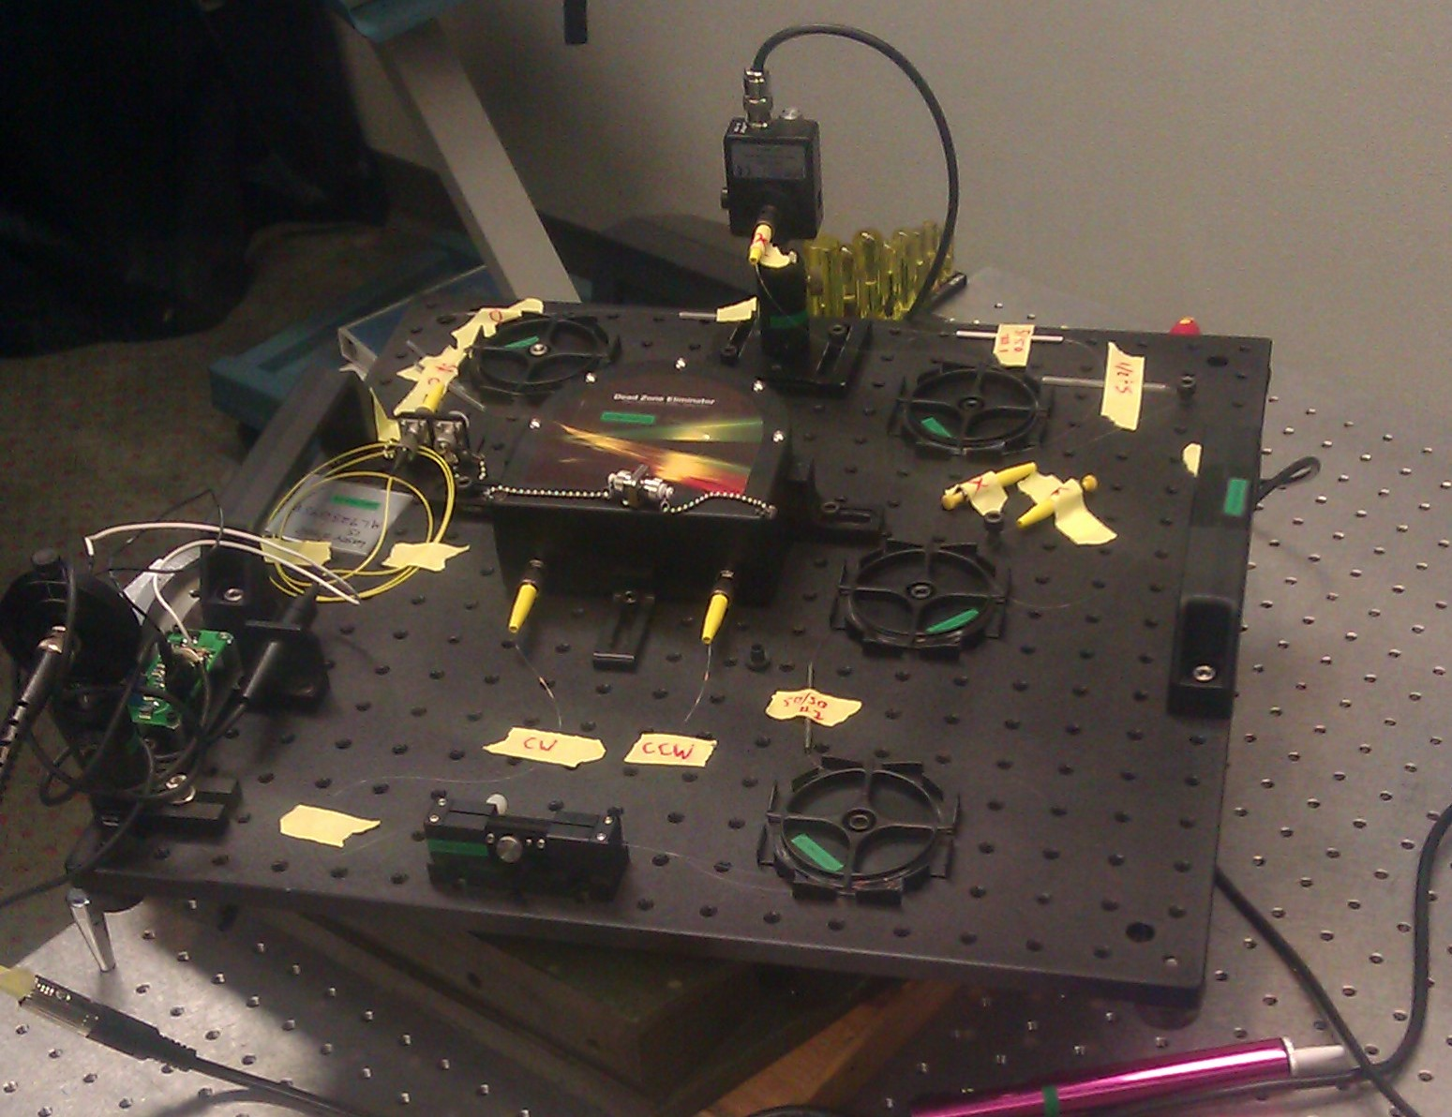
Final Iteration of Sagnac Interferometer

Slide 16
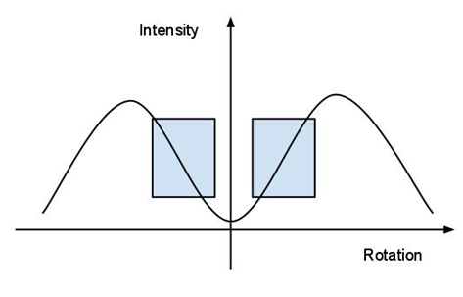
Data
Measuring relative intensity change under rotational influence
Rotational rate measurement, ΔV measurement

Slide 17
System Losses
Losses in optical power due to 50/50 coupling, backscattering, etc.

Slide 18
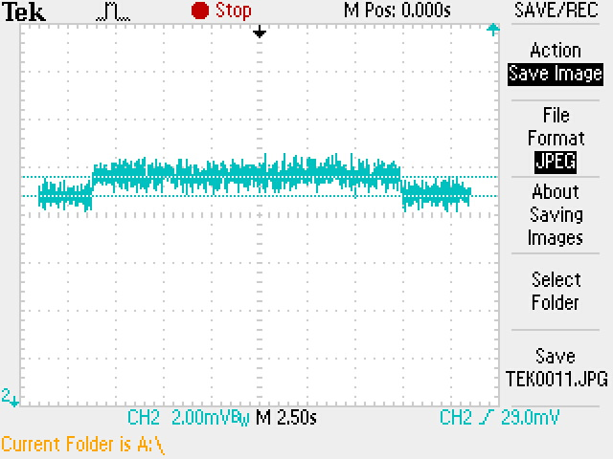
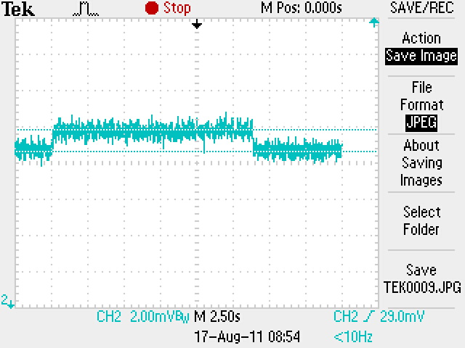
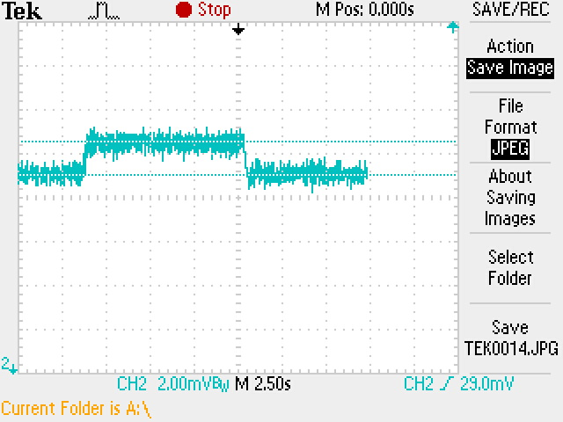
CW Rotation
Slow rotational rate (0.10 rad/s)
ΔV = 0.800mV
Regular rotational rate (0.15 rad/s)
ΔV = 1.20mV
Fast rotational rate (0.22 rad/s)
ΔV = 1.52mV

Slide 19
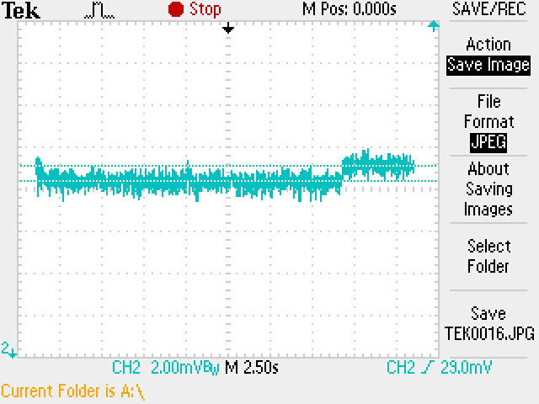
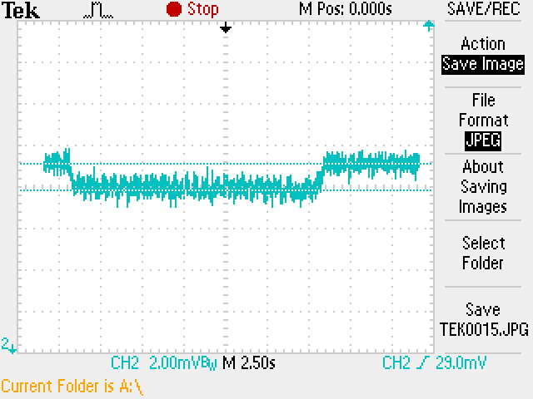
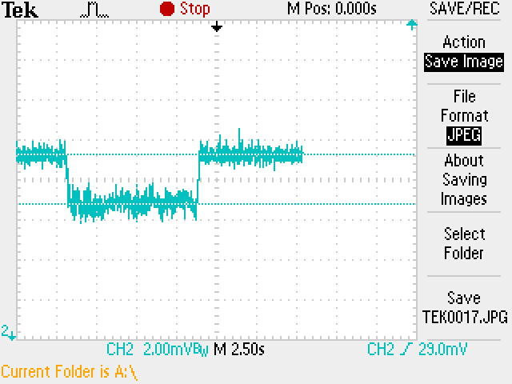
CCW Rotation
Slow rotational rate (0.079 rad/s)
ΔV = 0.720mV
Regular rotational rate (0.11 rad/s)
ΔV = 1.28mV
Fast rotational rate (0.20 rad/s)
ΔV = 2.48mV

Slide 20
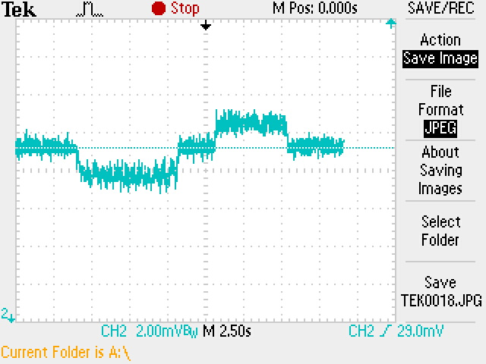
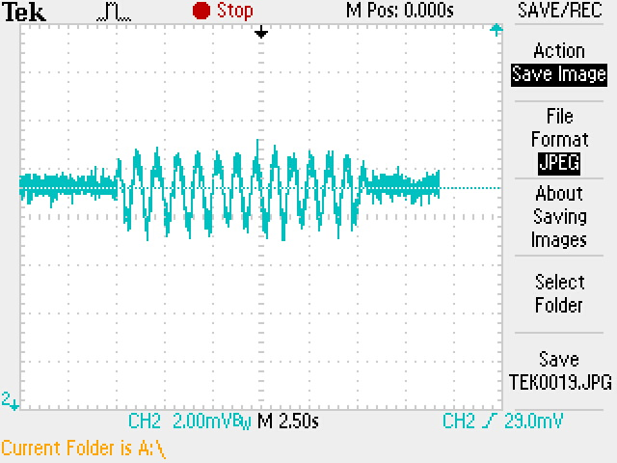
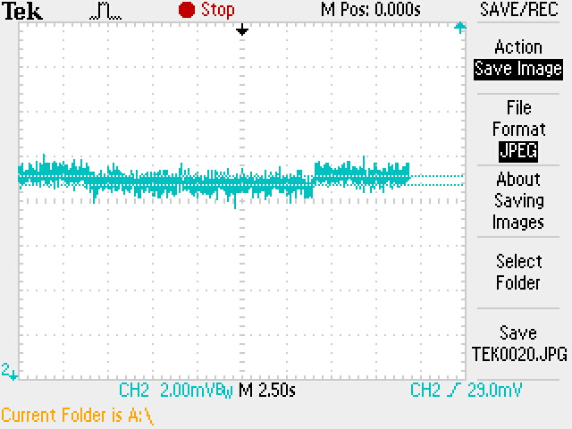
Data Cont.
Stable → CCW → stable → CW → stable
Swinging motion
Lower limit of detectable CCW rotation
0.0416 rad/s (~2 degrees per sec)

Slide 21
Rotational Rate and Intensity Shift

Slide 25
Conclusions
Able to discern Sagnac effect in a fiber optic setup
  Intensity change is linearly related to rotational rate
  Vibrational noise plays a large role
  Without a phase modulator, limited range of rotation rates
Phase modulator progress

Slide 26
Moving Forward
Implementation of phase modulator
Examine intensity shift dependence on phase difference
Phase shift nulling
  Integrated feedback circuit (PID loop) to control piezoelectric phase modulator
Complete FOG setup

Slide 27
Questions?

