Slide 1
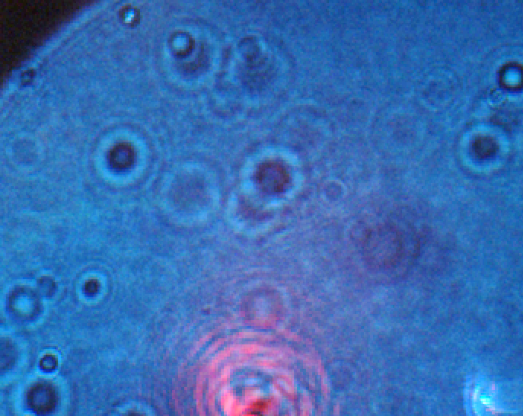
Optical Tweezers
Lincoln Connor
Maria Conneran

Slide 2
Outline
Project Goals
Optical tweezing theory and results
Sample preparation
Quadrant photodetector motivation and results
Future work

Slide 3
Goals
CCD imaging of optical trapping
Implement quadrant photodetector
Reorient detection wing
Manipulate biological sample

Slide 4
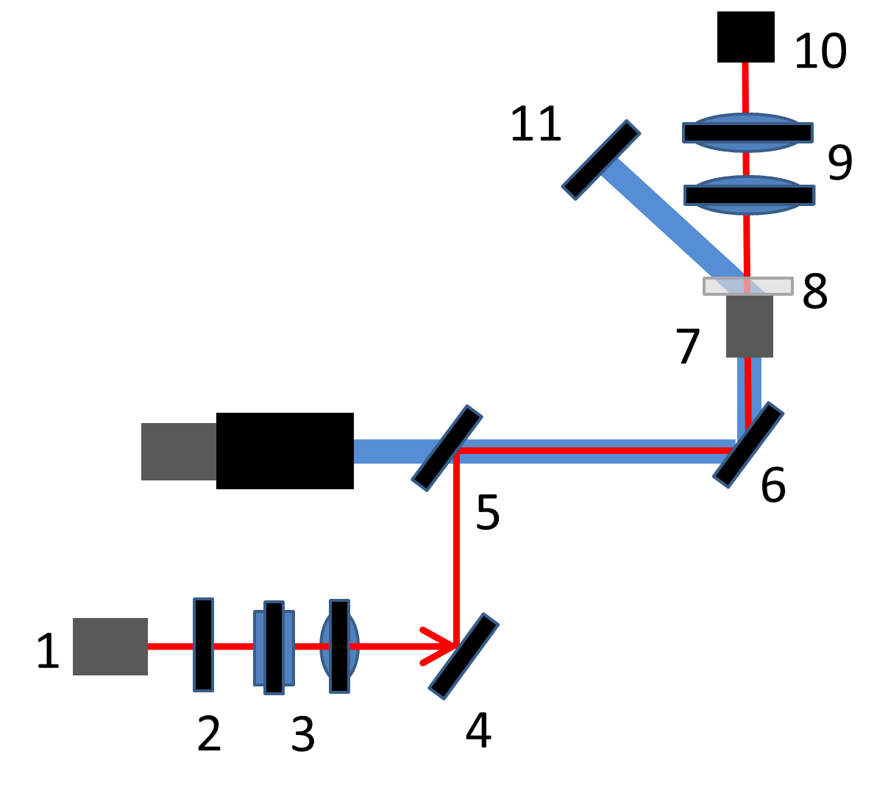
Setup

Slide 5
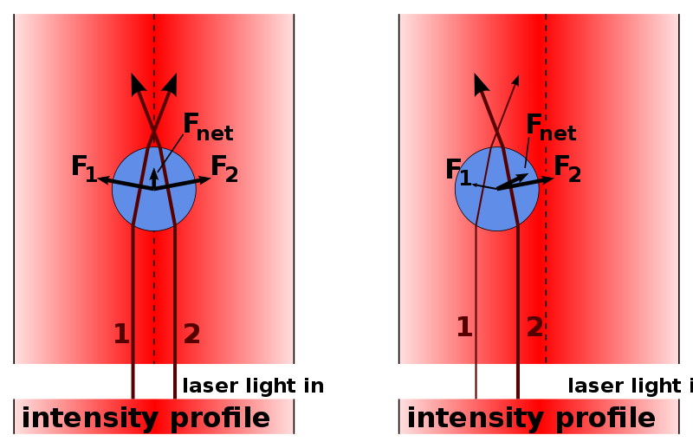
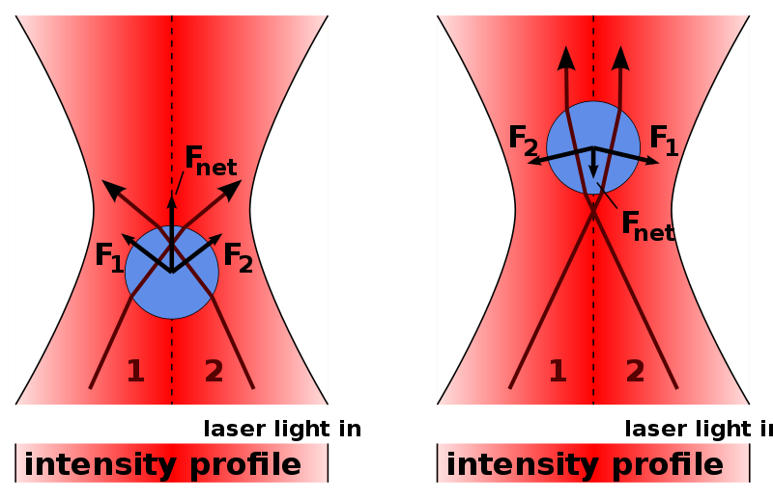
Optical Tweezing Theory
Different indices of refraction
Conservation of momentum
Equilibrium
 | R.Koebler optical trap/optical tweezer: explanation with unfocused laser

Slide 6
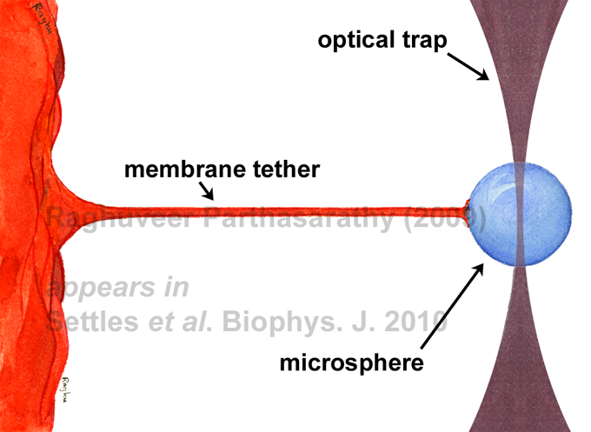
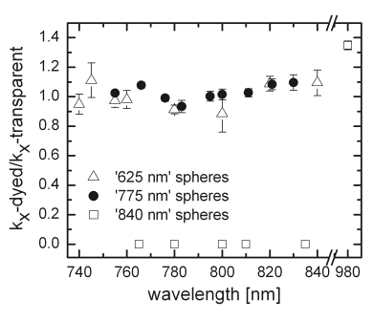
Applications for Optical Tweezers
Hold, measure/apply known force, local viscosity;
Parthasarathy Lab: McIntyre Lab:

Slide 7
Optical Trapping
Beam expander
Overfill back aperture
Video

Slide 8
Sample Preparation
Spacer
Sealants
Cleaning
Dilution
Sticky tape wells
Higher viscosity immersion oil

Slide 9
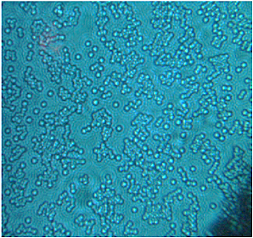
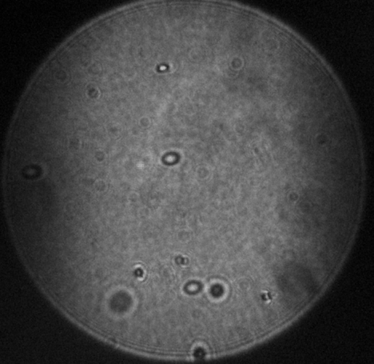
Dilution
1/1600

Slide 10
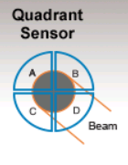
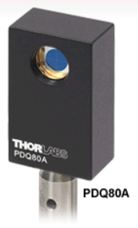
Quadrant Photodetector
Silicon (400-1050nm)
X, Y, SUM
150kHz bandwidth
Responsivity: 0.45A/W
Dark Current of 5nA
Recommended spot size: 1 mm to 3.9 mm

Slide 11
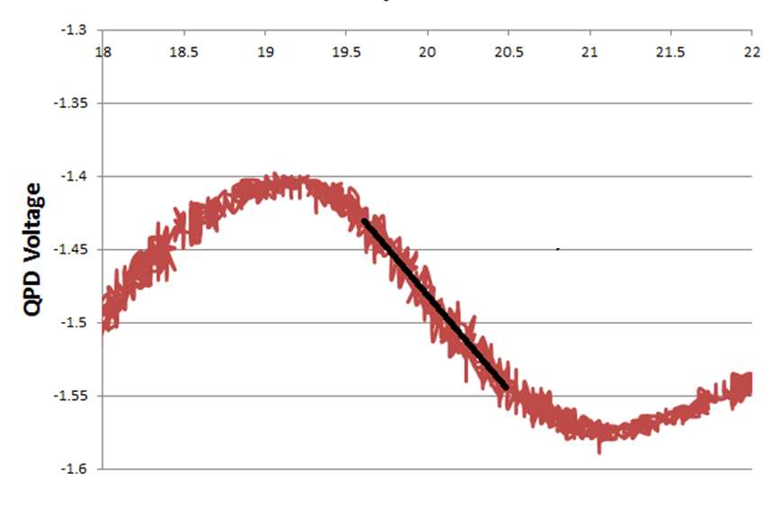
Calibration
Piezoelectric Voltage
5.37μm/V

Slide 12
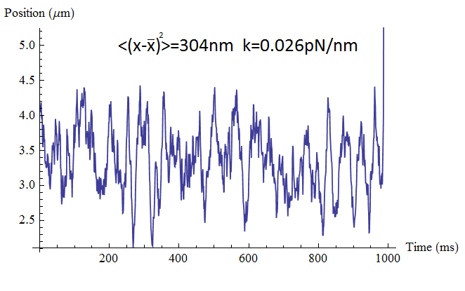
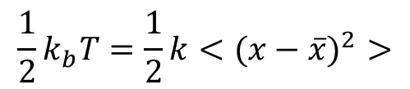
Equipartition
$$\frac{1}{2}k_{b}T=\frac{1}{2}k<(x−\overline{x})^{2}>$$

Slide 13
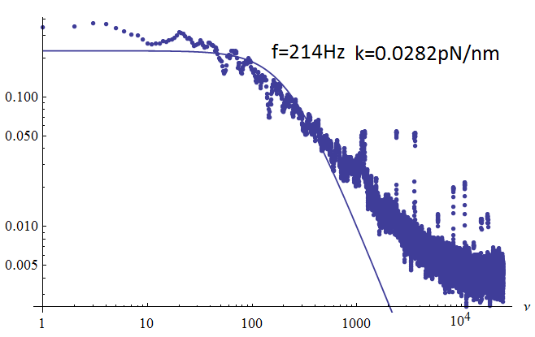

Lorentzian Fit
$$k=f2πβ$$

Slide 14
Suggestions for future work
Improve sample preparation
Improve stability
Detection beam
SLM implementation

Slide 15
Questions?

Slide 16
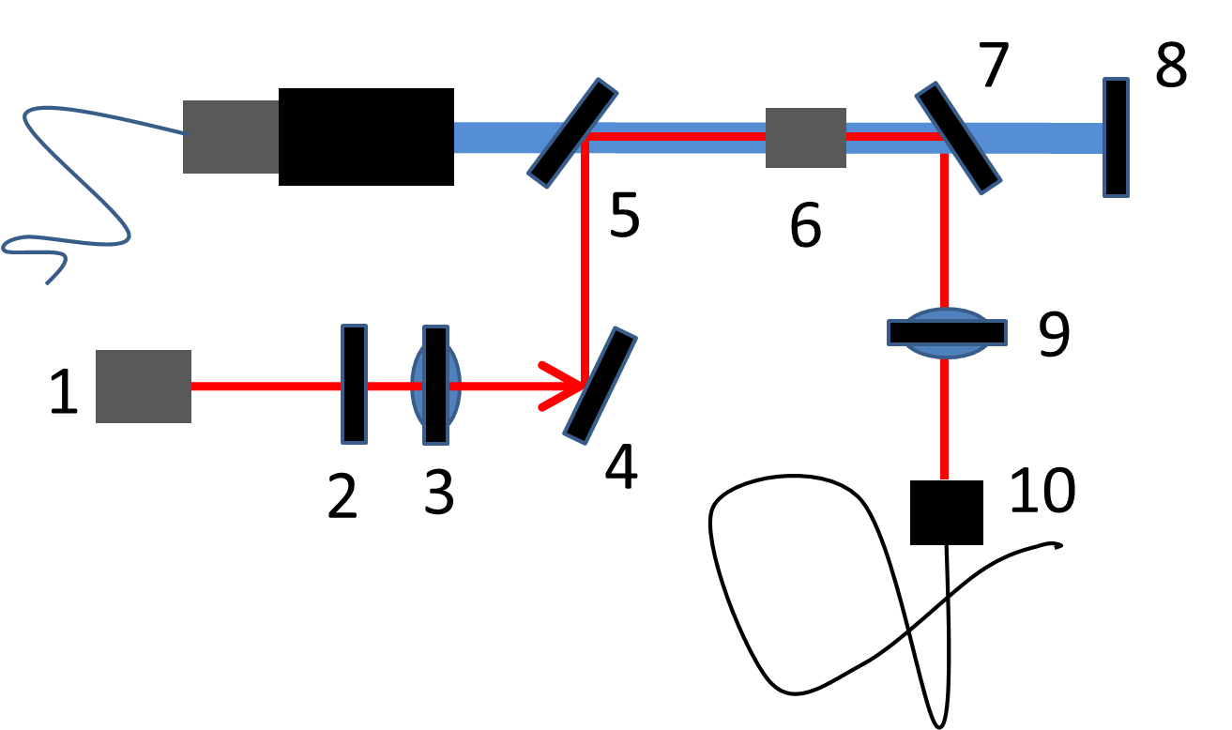
Horizontal Setup

Slide 17
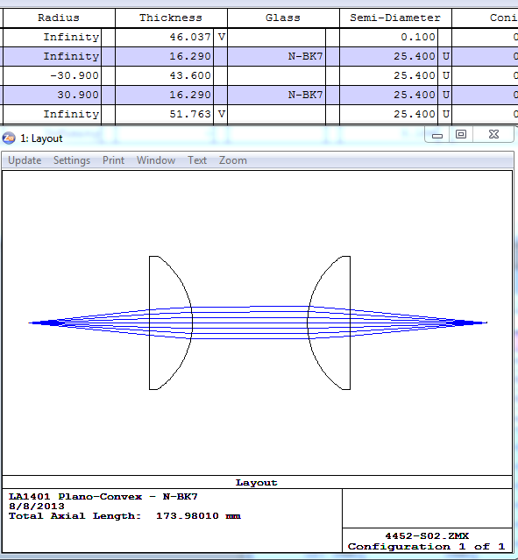
Lens System for QPD

Slide 18
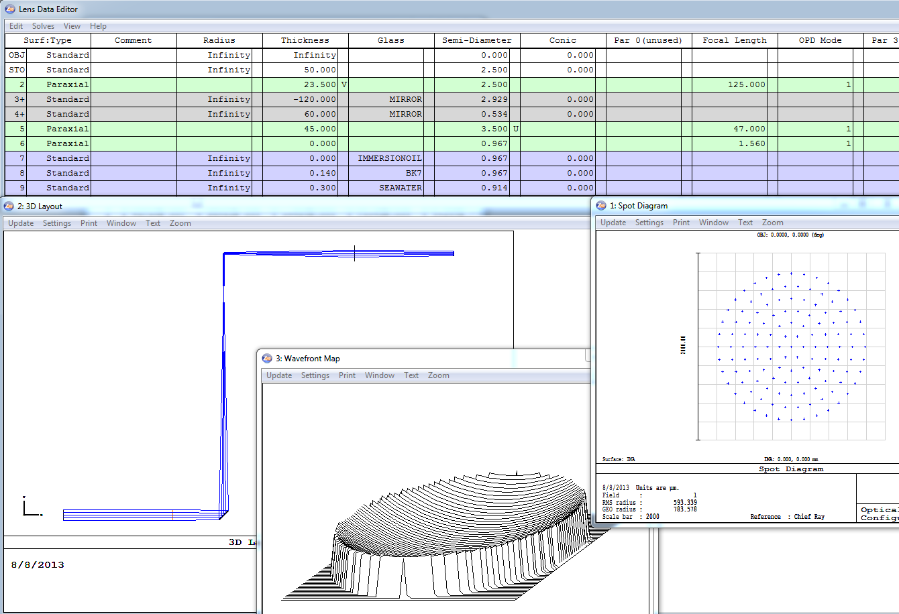

Slide 19
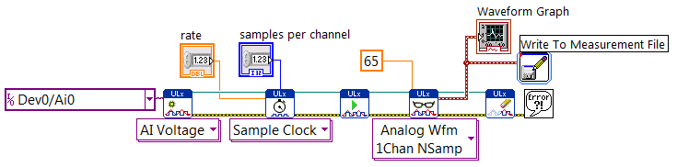
Data Acquisition

Slide 20
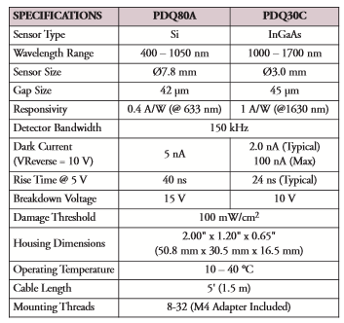
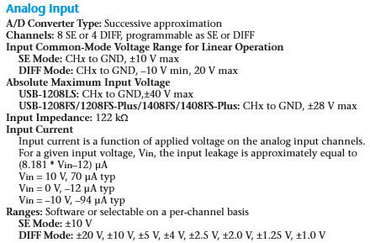
QPD
DAQ

Slide 21
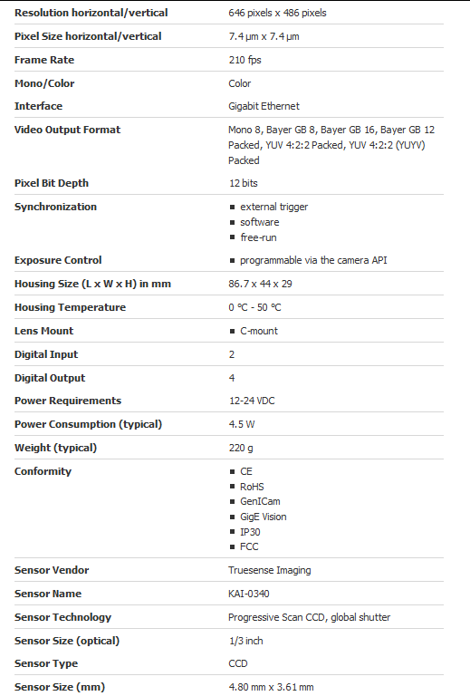
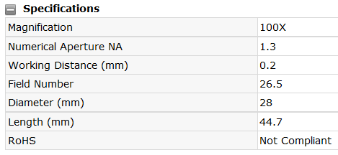
GigE Camera
Olympus 100x oil immersion
objective lens

Slide 22

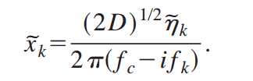


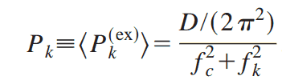
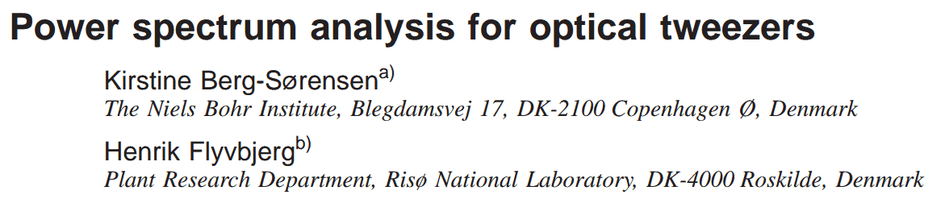
Einstein-Ornstein-Uhlenbeck

Slide 23
